Slide 1
Simple Audio Amplifier
Presented By :
Shaila Akther Jesi ( ET-241439)
Nusrat Zubaira Kamal (ET-241440)
Puja Dewanje (ET-241442)
Presented To :
Jubaida Nahar Tuli
Lecturer
Department of Electrical and Electronic Engineering
IIUC, Chattogram.

Slide 2
Presentation Outline
Introductive
Objective
Circuit Diagram
Required Equipments
Equipment Cost
Working Principle
Output
Advantages
Disadvantages
Application
Result
Future Plan
Conclusion

Slide 3
Introduction :
The simple audio amplifier is an electronic project that makes low-volume audio signals louder.
It uses a 2N6292 transistor to amplify signals from an audio source like a mobile phone or music player.
The weak input signal is fed into the transistor, which increases its power and sends it to a speaker.
This circuit is a great way to learn how transistors work in real-world audio applications.
It is simple, affordable, and perfect for students or hobbyists exploring basic electronics.

Slide 4
Objective
To build a working audio amplifier using the 2N6292 NPN transistor.
To understand the basic principle of signal amplification using a power transistor.
To increase the volume of weak audio signals so they can drive a speaker.
To create a low-cost and easy-to-build circuit for learning and demonstration purposes.
To explore the practical use of electronic components like resistors, capacitors, and transistors in real applications.

Slide 5
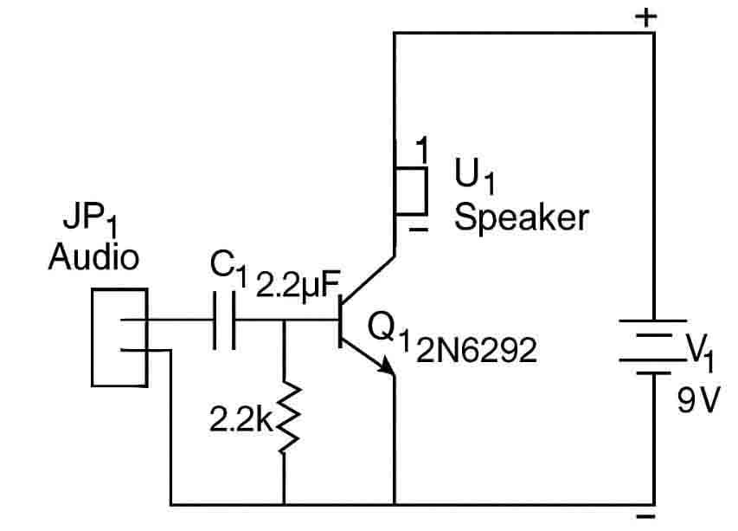
Circuit Diagram

Slide 6
Required Equipments
2N6292 NPN Transistor
2.2kΩ Resistor
22µF Capacitor
9V Battery
Jumper Wires
Breadboard
3.5mm Audio Jack
10W Speaker
Audio Source (Phone/MP3)

Slide 7
Equipment Cost
Name | Quantity | Price
2N6292 Transistor | 1 | 5
2.2ΚΩ Resistor | 1 | 2
22µF Capacitor | 1 | 5
9V Battery | 1 | 50
3.5 mm Audio Jack | 1 | 10
Jumper Wires | 5 | 30
10W Speaker | 1 | 350
Breadboard | 1 | 100
Total = | - | 552

Slide 8
Working Principle
The audio signal enters through the 3.5mm audio jack.
The signal passes through a capacitor to remove DC components.
The signal reaches the base of the 2N6292 transistor.
The transistor uses the 9V battery to amplify the weak signal.
A larger current flows from collector to emitter, boosting the signal.
The amplified signal is sent to the speaker.
The speaker produces a louder version of the original sound.

Slide 9
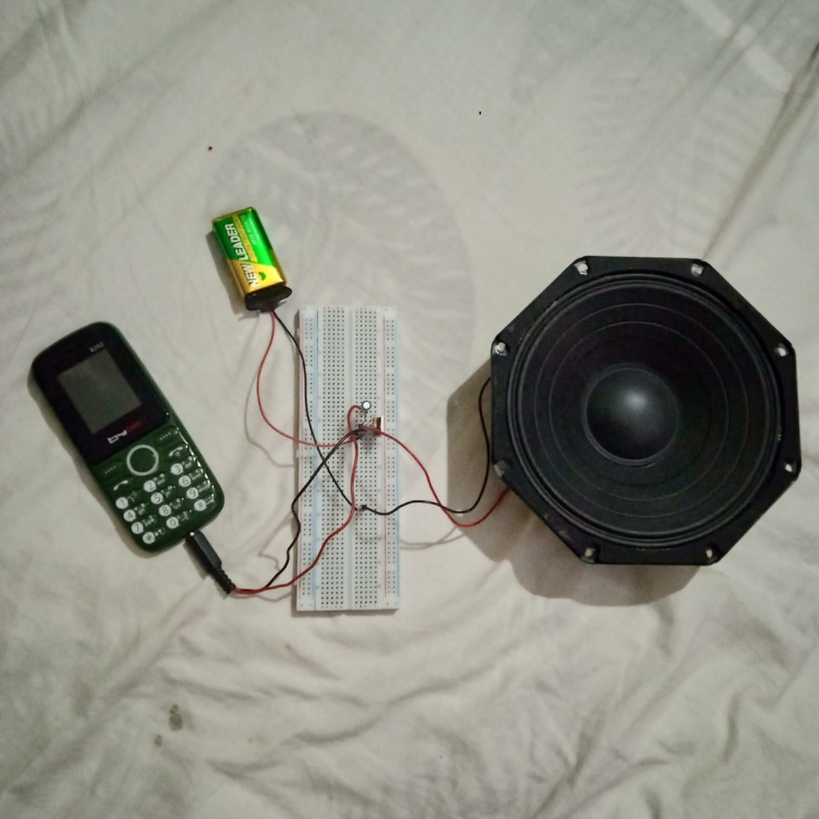
Output

Slide 10
Advantages
Low cost and easy to build.
Components are easily available.
Simple circuit design, good for beginners.
Low power consumption (uses 9V battery).
Useful for learning basic electronics and amplification.

Slide 11
Disadvantages
Limited sound output power.
May produce distortion at high volume.
Not suitable for professional audio systems.
Sound quality may not be very clear.
No volume or tone control features.

Slide 12
Application
Used in mini speaker systems for personal use.
Suitable for school or college electronics projects.
Helpful for learning and demonstrating transistor amplification.
Can be used in portable audio devices powered by a battery.
Ideal for DIY hobby projects and basic electronics practice.
Useful for testing audio signals from different sources like mobile phones or MP3 players.

Slide 13
Result
Successfully built a working audio amplifier circuit.
Weak audio signal was amplified clearly.
Speaker produced louder sound from mobile/MP3 input.
Circuit operated smoothly with a 9V battery2N6292 transistor
functioned effectively as an amplifier.
Project met the expected output and learning goals.

Slide 14
Future Plan
Upgrade the circuit to support stereo sound output.
Add volume and tone control knobs for better audio adjustment.
Replace breadboard with PCB design for permanent setup
Improve sound quality using filtering and feedback components.
Use higher wattage speakers for louder output.
Integrate with Bluetooth module for wireless audio input.
Power the circuit using rechargeable battery system.

Slide 15
Conclusion
Successfully amplified weak audio signals using 2N6292 transistor.
Simple and cost-effective circuit suitable for beginners.
Increased sound volume from audio devices clearly.
Demonstrated basic transistor amplification principles.
Potential for future improvements in sound quality and features.
Good educational project for learning electronics basics.

Slide 16
THANK YOU
Our Respected Teacher for your
Guidance and inspiration.

